Slide 1
KCSE DATA ANALYSIS
An exploratory analysis of KCSE dataset project assignment
(KamiLimu DataScience Track)
NB: For the full report visit:
https://github.com/MugoBrian/Kcse-Data-Analysis

Slide 2
Hypothesis
In my exploratory analysis, I used the hypothesis questions (formulated by Allan Gitau after our group discussion)
Has performance improved or declined?
Has the number of candidates increased or decreasaed?
What is the difference between male and female performance?
Has the gap in gender difference increased or decreased?
How do the quality grades (A – C+) compare to non-quality grades(C – E)?
What is the trend seen from the data over the years?
What is the most common grade (mode, mean)?
NB: For the full report visit https://github.com/MugoBrian/Kcse-Data-Analysis

Slide 3
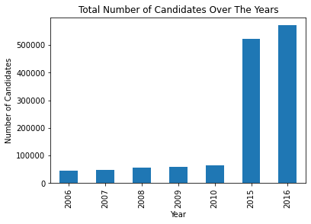
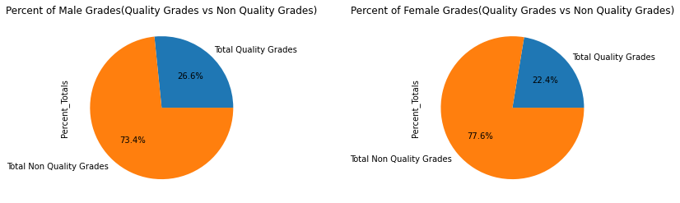
Findings
The performance of all candidates (both male and female) increased from the year 2006- 2015
The total number of male candidates is higher than female candidates from the year 2006 – 2015.
There is an increase in the number of total candidates over the past years.
The number of quality grades is lower than the number of non quality grades over the years.
The percentage of quality grades of male candidates is higher than that of female candidates over the years.
The percentage of non quality grades of male candidates is lower than that of female candidates over the years

Slide 4
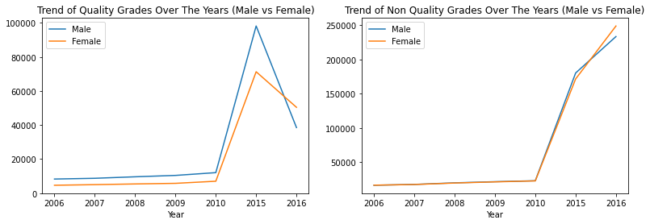
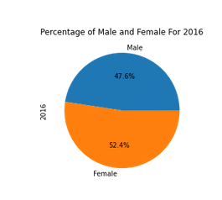
Exception Observation ( What caught my eye)
In 2016:
Total number of quality grades in female candidates is higher than that of male candidates. Total number of non quality grades in female candidates is higher than that of male candidates.
Total number of female candidates is higher than male candidates.
NB: For the full report visit https://github.com/MugoBrian/Kcse-Data-Analysis

Slide 5
Conclusion
The number of candidates increases over the years.
Number of quality grades is lower than the number of non quality grades irrespective of the gender.
Generally, the number of male candidates is higher than the number of female candidates.
Male candidates perform better than the female candidates
More male candidates meet the cut off points compared to female candidates over the past years.
NB: For the full report visit https://github.com/MugoBrian/Kcse-Data-Analysis

